Slide 1











VOLTAGE OUTPUT BASED TEMPERATURE SENSOR
USING THERMISTOR AND OP AMP 741
TEAM MEMBERS
16 Gaurav Bind
17 Ameya Ganpatye
21 Ashish Ranjan
29 Shreerang Mhatre
30 Sugandh Kedia

Slide 2
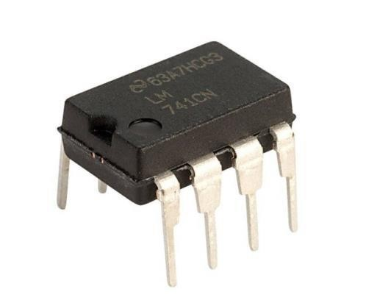
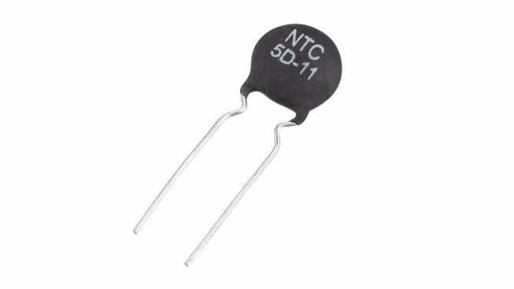
OVERVIEW
• This Temperature Sensor Circuit gives voltage output according to the temperature in which it is present and hence, can be used to measure/sense temperature.
• There is a linear dependence between the temperature and the voltage output which can be measured through this circuit.
• The major two components of this circuit are an Op Amp (741) and a NTC Thermistor.

Slide 3
NTC THERMISTOR
• A Thermistor is a thermal resistor, that is, a temperature dependent resistor. Its resistance depends on the temperature of the environment it is placed in.
• Usually all resistors are dependent on temperature but there is no formal
relation between temperature and resistance.
• In the case of thermistors, there is a relation which is present between temperature and resistance.
Δ𝑅=𝑘∙Δ𝑇
• Here, Δ𝑅 is change in resistance, Δ𝑇 is change in temperature and 𝑘 is temperature coefficient of resistance.

Slide 4
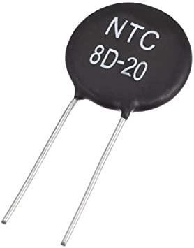
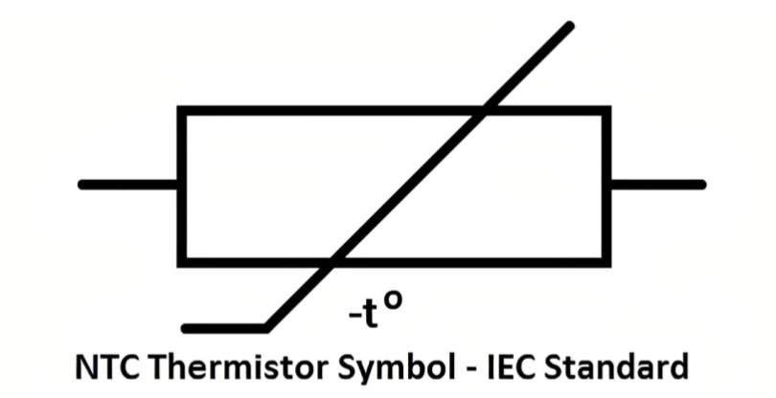
NTC THERMISTOR
• An Negative Temperature Coefficient Thermistor is a Thermistor whose Temperature coefficient of resistance, 𝑘, is negative.
• This implies than the resistance of an NTC Thermistor decreases with increase in temperature.
• An NTC Thermistor is used in this
Temperature Sensor Circuit.

Slide 5
COMPONENTS
• R5: 470 Ω
• R6, R7: 100 K Ω
• R8, R9: 680 K Ω
• IC1: LM741 Op Amp
• C1: 0.1uF Capacitor
• ZD1: 6.8V Zener Diode
• VR1: 10K Ω Potentiometer
• R4: 10K Ω NTC Thermistor
• R1,R2,R3: 10 K Ω

Slide 6

INTERNALS OF LM 741

Slide 7
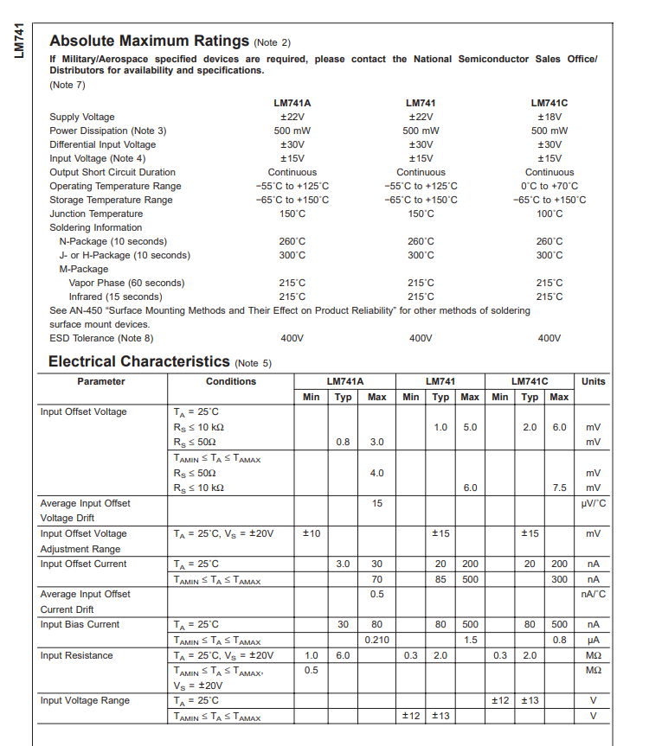
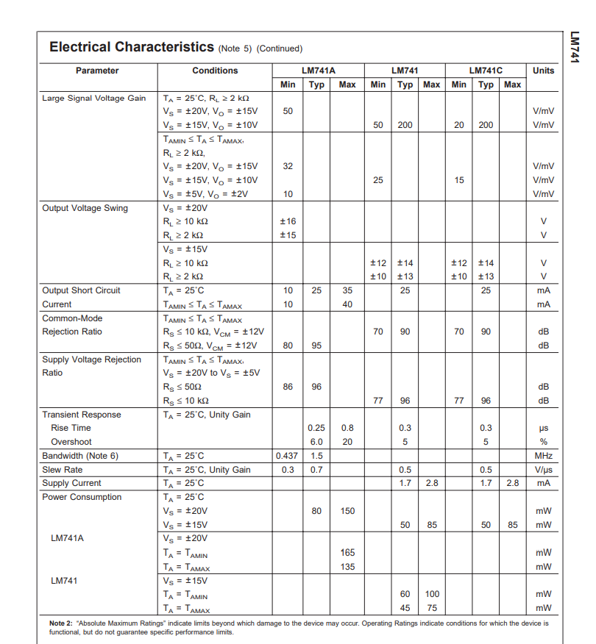
Datasheet of LM741 IC (OPAM - 741)

Slide 8
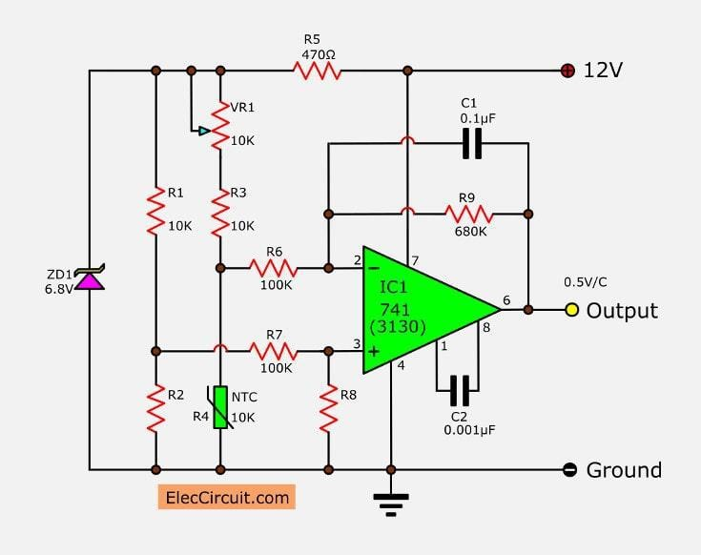
CIRCUIT DIAGRAM

Slide 9
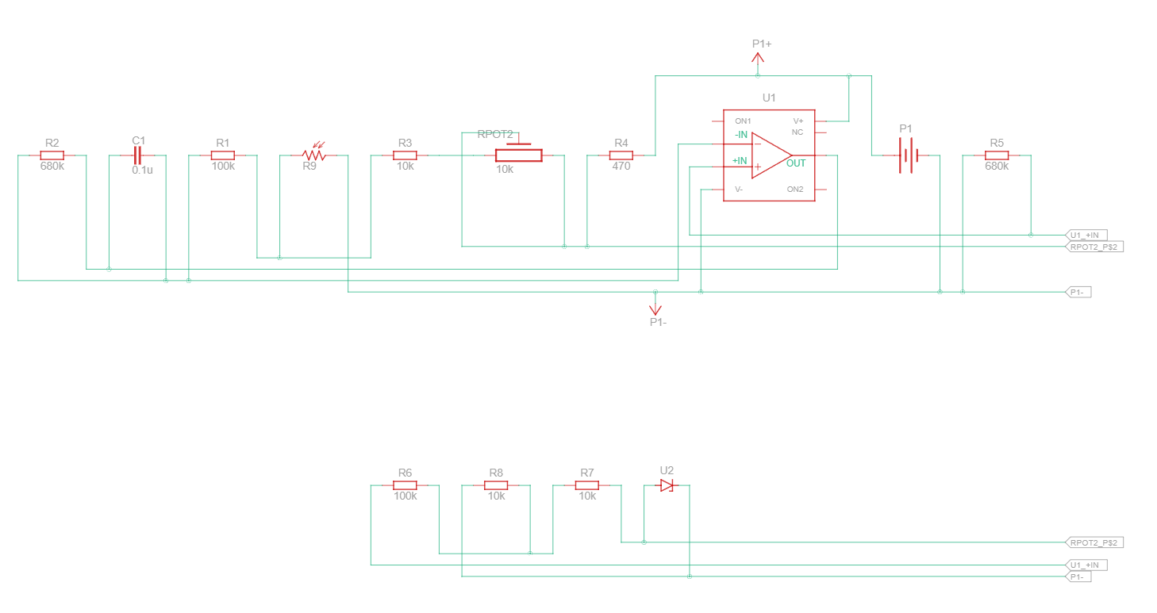
Tinkercad Circuit Diagram

Slide 10
WORKING
• Here the OpAmp 741 is used as a differential amplifier.
• An NTC Thermistor is used to sense the temperature i.e. with increase in
temperature the resistance of the thermistor decreases.
• The change in resistance changes the input voltage and accordingly the output.
• This setup is able to provide linear temperature voltage dependence.
• The change in voltage according to change in temperature visible is 0.5V/ C.
• The voltage output is measured using a multimeter.

Slide 11
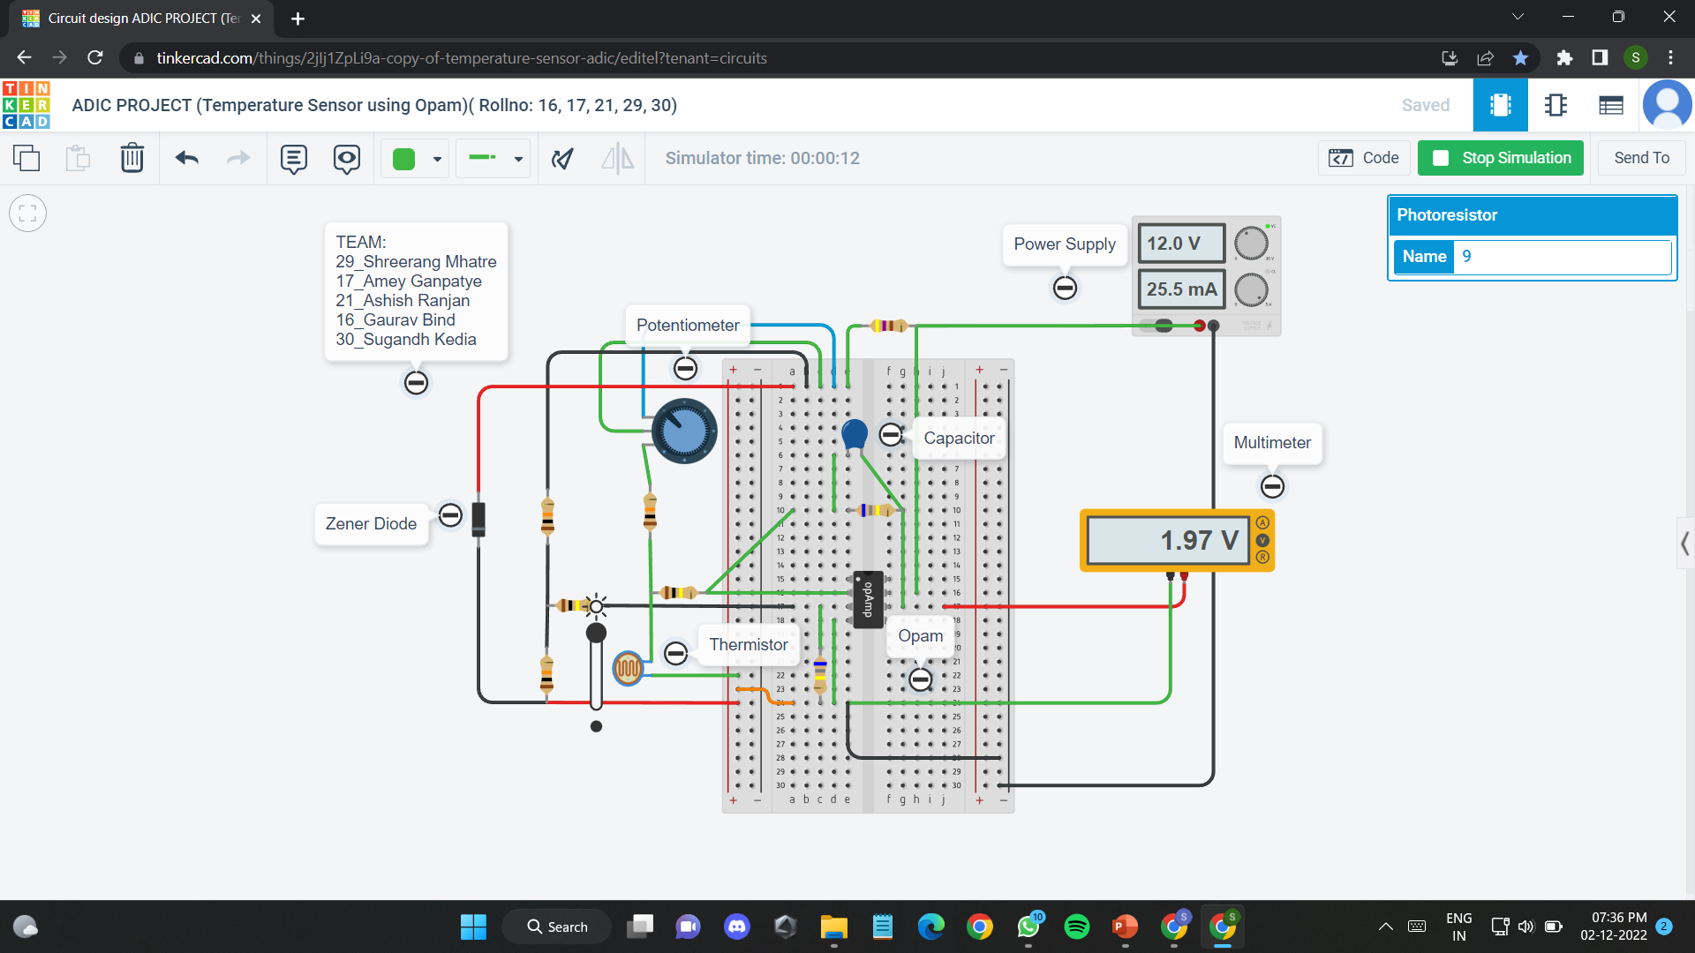
PROJECT SIMULATION

Slide 12
THANK YOU
Analog and Digital Integrated Circuits
SY BTech Electrical and Computer Engineering (A.Y. 2022-23)
TEAM MEMBERS
16 Gaurav Bind
17 Ameya Ganpatye
21 Ashish Ranjan
29 Shreerang Mhatre
30 Sugandh Kedia

